Slide 1
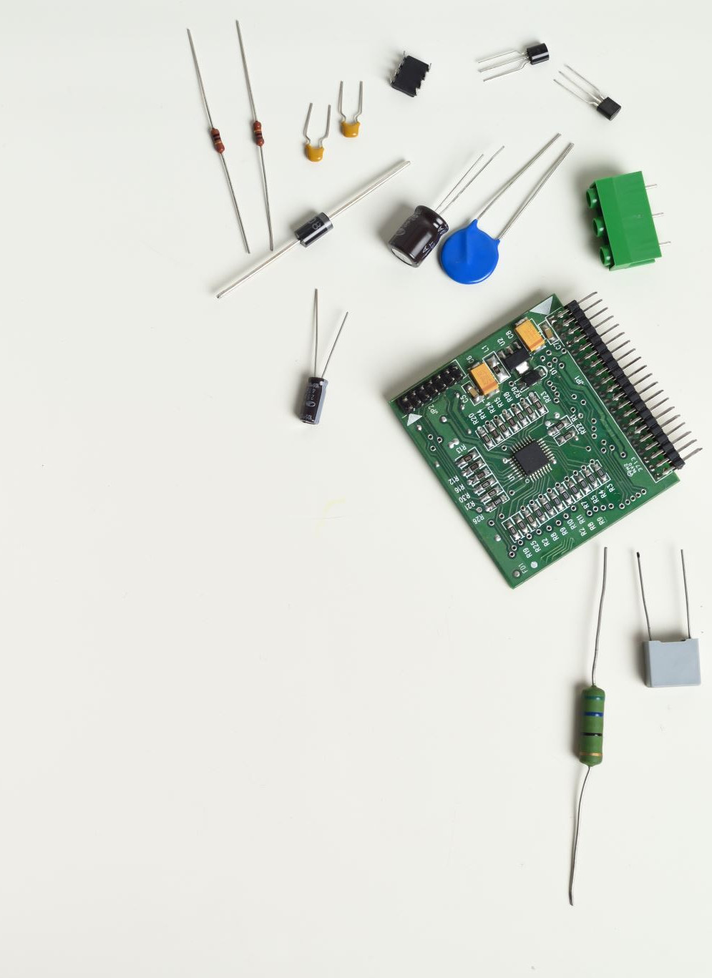
Design and Automation of VGA
مضخم بكسب قابل للتغيير
Graduation Project Proposal Year 2022/2023
Presented By : Mario Samir – Aya Abdelwahed

Slide 2
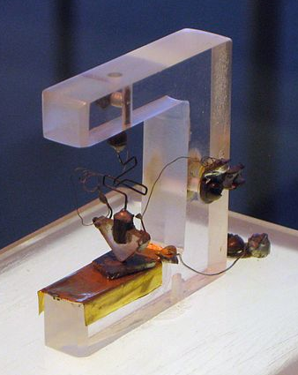
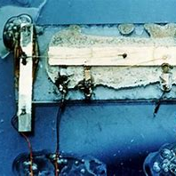
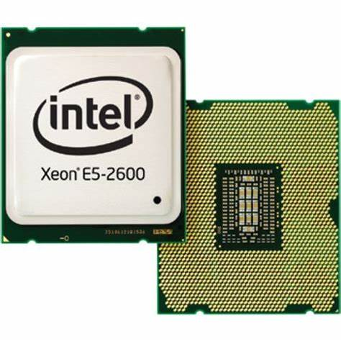
First Transistor & First IC
First transistor
First IC
Now Days
The first transistor
Size of 100 µm
(Bell labs, 1947)
Only one transistor
Only (+R+C)
( Texas instruments ,1958 )
Xeon E5 Microprocessor 2.26 billion transistors! ( Intel, 2012 )

Slide 3
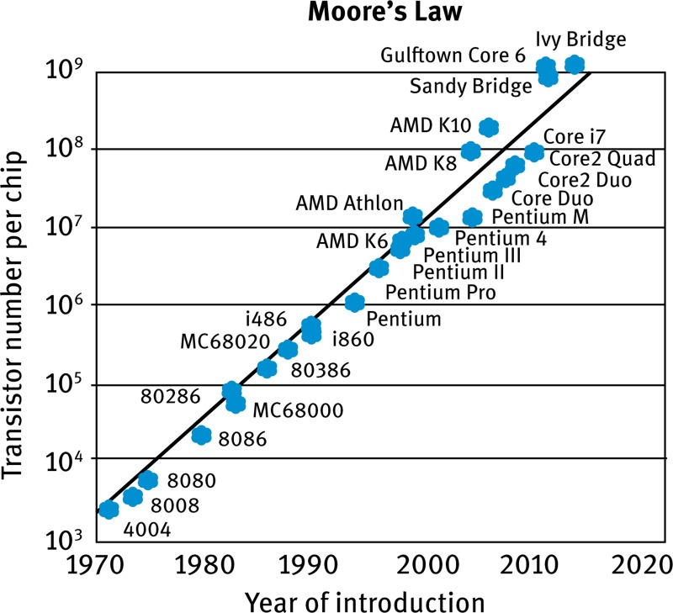
MOSFET scaling
(process nodes)
100 µm - 1947
10 µm – 1971
1 µm – 1984
130 nm – 2001
65 nm – 2005
32 nm – 2009
22 nm – 2012
14 nm – 2014
10 nm – 2016
7 nm – 2018
5 nm – 2020
3 nm – 2022 Future 2 nm ~ 2024

Slide 4
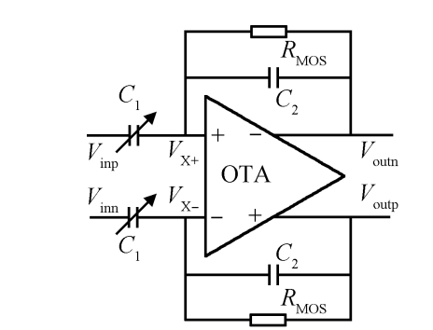
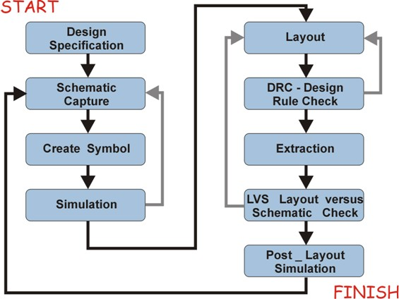
Project’s Scope
Designing layout of a fully differential Variable Gain Amplifier (VGA).
Running post layout sims (PEX).
Creating Automation scripts for the VGA design cycle (schematic/layout).
Automation
Creating Automation scripts for design cycle
(schematic/layout)

Slide 5
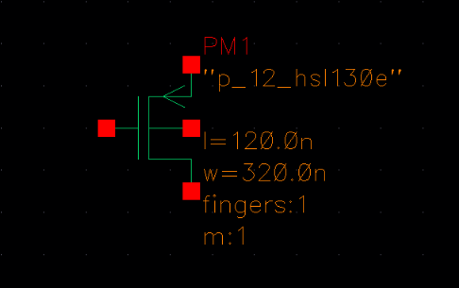
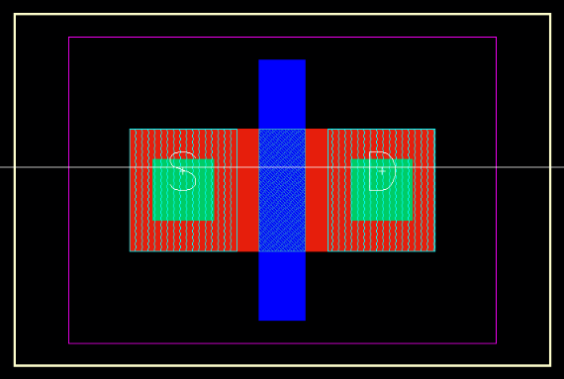
Schematic VS Layout

Slide 6
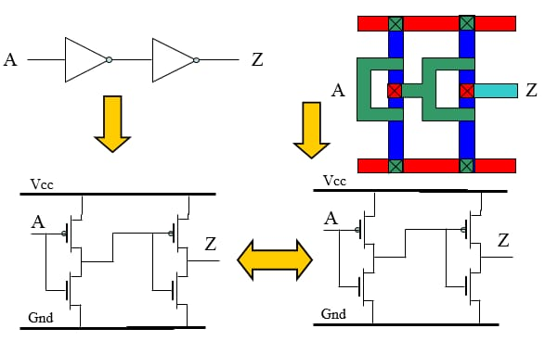
Schematic VS Layout

Slide 7


Why is layout is so important ?
Good design + Good layout
= Successful Product
Good design + bad layout
= Faulty Product

